Slide 1
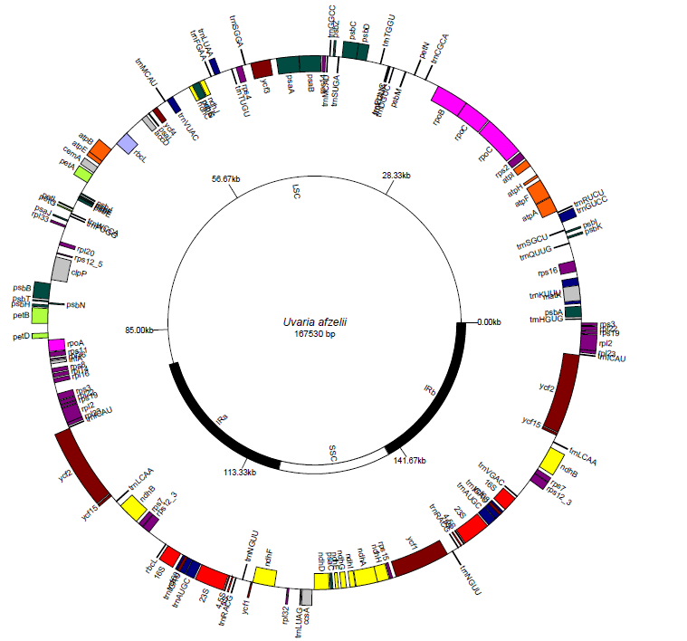
Inversion
 | ATP synthase
 | Cytochrome related
 | NADH dehydrogenase
 | Transfer RNA
 | Photosystem subunits
 | Plastid-encoded RNA polymerase
 | Ribosomal protein subunit
 | Ribosomal RNA
 | Rubisco subunit
 | Other
 | Unknown function (ycf)

